Slide 1
Vina phone postpaid billing

Slide 2
Mô hình khối chức năng hệ thống
NETWORK
RATING
CCBS
MSCs
GGSN/ SGSN
Data Mediation
Postpaid Rating Configuration
Billing (Adjustment & Promotion)
Debt Management
WEB UI
VNP BSS POS (23 incl. HN, HCM)
VAS
Rating & Charging & Standard Promotion for Post paid
Service Provisioning
Invoice & Payment
HLRs
P&T BSS POS (41)
SMSCs
VNP BSS
Other NEs
Service Activation
Data warehousing & Reporting
Trouble Ticketing & Customer Enquiry
Payment GW (Bank Transfer / ATM / Easy Pay)
Roaming & Settlement

Slide 3
Mô hình trao đổi thông tin hiện tại
NETWORK
RATING
CCBS
MSCs
GGSN/ SGSN
Data Mediation
Prepaid / Postpaid xDR classification
Postpaid Rating Configuration
Billing (Adjustment & Promotion)
Debt Management
WEB UI
VNP BSS POS (23 incl. HN, HCM)
VAS
xDR
Rating & Charging & Standard Promotion for Post paid
Postpaid
xDR
Service Provisioning
Invoice & Payment
HLRs
P&T BSS POS (41)
SMSCs
VNP BSS
Other NEs
Service Activation
Data warehousing & Reporting
Trouble Ticketing & Customer Enquiry
Payment GW (Bank Transfer / ATM / Easy Pay)
Roaming & Settlement

Slide 4
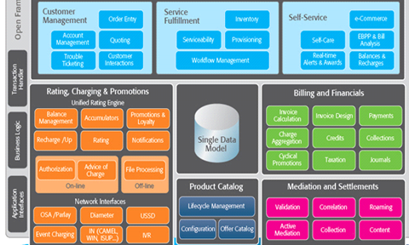
Mô hình tích hợp triển khai
NETWORK
RATING
CCBS
Data Mediation
Prepaid / Postpaid xDR classification
Postpaid Rating Configuration
Billing (Adjustment & Promotion)
Debt Management
WEB UI
MSCs
GGSN/ SGSN
VNP BSS POS (23 incl. HN, HCM)
xDR
Postpaid
xDR
VAS
Rating & Charging & Standard Promotion for Post paid
Service Provisioning
Invoice & Payment
HLRs
P&T BSS POS (x/41)
SMSCs
VNP BSS
Service Activation
Data warehousing & Reporting
Trouble Ticketing & Customer Enquiry
Payment GW (Bank Transfer / ATM / Easy Pay)
Roaming & Settlement
Other NEs
Comverse Postpaid
System Interface
CAP2
xDR

Slide 5
Thay thế rating
NETWORK
CCBS
MSCs
GGSN/ SGSN
Billing (Adjustment & Promotion)
Debt Management
WEB UI
VNP BSS POS (23 incl. HN, HCM)
VAS
Service Provisioning
Invoice & Payment
RATED XDR
HLRs
P&T BSS POS (41)
SMSCs
VNP BSS
Service Activation
Data warehousing & Reporting
Trouble Ticketing & Customer Enquiry
Payment GW (Bank Transfer / ATM / Easy Pay)
Roaming & Settlement
Other NEs
Comverse Postpaid
System Interface
CAP2
RAW XDR

Slide 6
Tương lai mô hình hội tụ hoàn toàn
NETWORK
VNP BSS
P&T BSS POS (64)
MSCs
GGSN/ SGSN
Service Activation
Data warehousing & Reporting
Trouble Ticketing & Customer Enquiry
Payment GW (Bank Transfer / ATM / Easy Pay)
Roaming & Settlement
VAS
HLRs
Comverse Postpaid
System Interface
SMSCs
RAW XDR
WEB UI
Other NEs

